Slide 1
Civilian Permanent Duty Travel WTA and RITA Entitlements
AFIMSC/FMFK
Feb 2024

Slide 2
Purpose
Employee Education on Withholding Tax Allowance (WTA) and Relocation Income Tax Allowance (RITA) Entitlements

Slide 3
Overview
Applicable Regulations/Resources
Civilian Entitlements
Mandatory Taxes
Withholding Tax Allowance (WTA)
Relocation Income Tax Allowance (RITA)
Examples of RITA with and without WTA advance reconcilation
Resources/Points of Contact

Slide 4
Regulations/Resources
Joint Travel Regulation: Chapter 5 Part F
https://media.defense.gov/2022/Jan/04/2002917147/-1/-1/0/JTR.PDF
Federal Travel Regulation: Chapter 302
https://www.gsa.gov/policy-regulations/regulations/federal-travel-regulation
DoDFMR Vol 9: Chapter 6
https://comptroller.defense.gov/Portals/45/documents/fmr/Volume_09.pdf
AFMAN 65-114: Chapters 11
https://static.e-publishing.af.mil/production/1/saf_fm/publication/afman65-114/afman65-114.pdf

Slide 5
Civilian PDT Entitlements

Slide 6
Mandatory Tax Calculation
FERS Tax Computation
FITW 22%
FICA 7.65%
Social Security 6.2%
Medicare 1.45%
Total taxable amount 29.65%
If WTA is elected, it is also calculated at 28.20512%.
This is due to the fact that WTA is also taxable and has to cover the tax of the entitlement as well as the tax on the WTA itself.
Exception – CSRS retirement does not calculate Social Security (6.2%).
This is a retirement option that was only available to employees hired prior to 1 January 1987.

Slide 7
What is Withholding Tax Allowance?
WTA, if elected, is paid as part of each travel claim processed, this is considered year one.
WTA is effectively an advance of the 22% FITW on your PCS claims.
WTA does not cover state taxes, local taxes, or FICA (Medicare or Social Security taxes).
WTA is optional and must be requested by the employee when vouchers are submitted.
Vouchers cannot be corrected to add WTA in after payment has been made.
You cannot retroactively process WTA on completed vouchers. RITA can be filed the next year.
All travelers who elected WTA must file a RITA the following year after taxes with the IRS have been filed. Failure to file a RITA will result in a debt of the WTA.
Note – Tax situations are unique to all travelers. We are not tax experts. Remember that WTA is advanced at 22%. If the traveler believes they will fall in a lower tax bracket and elect to take WTA; they may be over “advanced”. When the RITA is computed they will receive a debt for the overpayment which should be offset by a refund on the tax return.

Slide 8
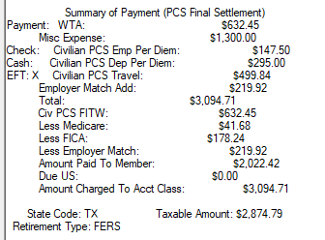
Example of WTA Calculation
Employee PCS’d from GA to TX
Employee was paid:
Mileage for 2 povs = $499.84
Per diem for travel = $442.50
MEA = $1,300.00
Total taxable amount = $2,242.34
Employee requested WTA
$2,242.34 x 28.20512% = $632.45 (WTA)
$2,242.34 + $632.45 = $2,874.79 NEW taxable amount
All taxes are now calculated using the new taxable amount.
$2874.79 x 22% = $632.45 FITW
$2874.79 x 6.2% = $178.24 FICA (Social Security)
$2874.79 x 1.45% = $41.68 Medicare
RTS computation:

Slide 9
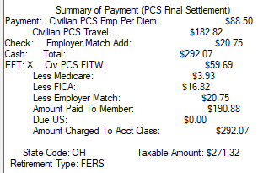
Example of Without WTA Calculation
Employee PCS’d from OH to MS
Employee was paid:
Mileage for 1 pov = $182.82
Per diem for travel = $88.50
Total taxable amount = $271.32
Employee did not requested WTA
$271.32 x 22% = $59.69 FITW
$271.32 x 6.2% = $16.82 FICA (Social Security)
$271.32 x 1.45% = $3.93 Medicare
RTS computation:

Slide 10
Relocation Income Tax Allowance (RITA)
RITA is designed to reimburse the traveler for the increased tax burden incurred on a PCS.
RITA is based on the traveler’s marginal tax rate, which is determined by their actual taxable income and filing status with the IRS. This is why RITA is a two-year process.
RITA also reimburses state and local taxes incurred because of the PCS.
The RITA computation itself is taxable at 29.65% (22% FITW and 7.65% FICA/Medicare).
RITA must be filed if WTA is elected. The WTA advance will be reconciled on RITA. If no RITA is filed, a debt will be established for the WTA advance.
Employees who elect not to take WTA are still eligible to file a RITA.
In cases where claims are filed in multiple years, RITA will reflect on the W-2, but not in the covered taxable reimbursements that following year.
In other words, you can’t file a RITA on a RITA.

Slide 11
Relocation Income Tax Allowance (RITA)
The Air Force uses the 2 Year RITA process. (Reference FTR 302-17.66)
When relocation entitlements are paid, that is considered year one.
RITA is filed the following year after taxes have been filed with the IRS. This is because the taxable income is not known until the federal tax return is completed. IRS determines the tax bracket the employee is in for that year.
It is possible to span payments across two calendar years. This would require a RITA in the following year for each payment.
PCS/TQSE/MEA paid in November 2023 = RITA in 2024
Real Estate paid in February 2024 = RITA in 2025
Government HHG Shipment paid in March 2024 = RITA 2025
Reminder: When processing RITA in multiple years, the RITA amount from the previous year does not affect the RITA done the following year. You can’t file RITA on RITA.

Slide 12
Required Documents to File a RITA
Complete set of orders to include all amendments.
RITA Certification Form
If filing jointly, the spouse must sign the RITA Certification Form. If a spouse can’t sign, a memo is required why they can’t sign. We typically see this if a spouse is deceased.
Copy of the IRS 1040/1040EZ. Taxable income can be verified by the FMF Office, if verified by the FMF office on the RITA certification form, those tax documents aren’t needed in the document set.
1351-2 claiming RITA and year. Example RITA 23
EFT form – Travel Pay Ellsworth does not have access to civilian EFT information.
All signatures must be either wet signed or digitally signed with the CAC card containing the DOD ID number. Other forms of electronic signature, such as Adobe, are not authorized.

Slide 13
RITA Formula – FTR 302-17.67
C = CMTR
R = Reimbursements, allowances, and direct payments to vendors covered by WTA during Year 1
Z = Total grossed-up WTAs paid during Year 1.
Note: If the employee has declined the WTA, enter zero for element Z in the above calculation.

Slide 14
CMTR – FTR 302-17.40
Combined Marginal Tax Rate (CMTR) = a combination of your Federal, state, and local tax rates.
However, the CMTR cannot be calculated by merely adding the Federal, state, and local marginal tax rates together because of the deductibility of state and local income taxes from income on your Federal income tax return.
The formula for calculating the CMTR is:
CMTR = F + (1 − F)S + (1 − F)L
F = Your Federal marginal tax rate
S = Your state marginal tax rate, if any
L = Your local marginal tax rate, if any
The agency finds the Federal marginal tax rate by comparing their taxable income, as shown in their “Statement of Income and Filing Status,” to the Federal tax tables in the current year's Form 1040.
The agency finds the state marginal tax rates that apply to the employee (if any) by comparing their taxable income to the most current state tax tables provided by the states.

Slide 15
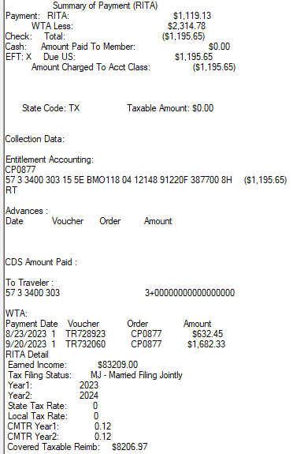
RITA with WTA
The employee was paid two taxable vouchers in 2023
TR728923 – Taxable Amount $2874.79 – WTA paid $632.45
TR732060 – Taxable amount $7,646.96 – WTA paid $1682.33
According to the taxable income of $83,209.00 on the IRS 1040, the employee falls into the 12% tax bracket.
The RITA is computed to pay taxes at the CMTR for 2023.
WTA is advance at the federal tax rate of 22%.
The employee was over advanced and will have a debt.
Had the employe not requested WTA, this RITA voucher would have resulted in a payment for the taxes at 12%.

Slide 16
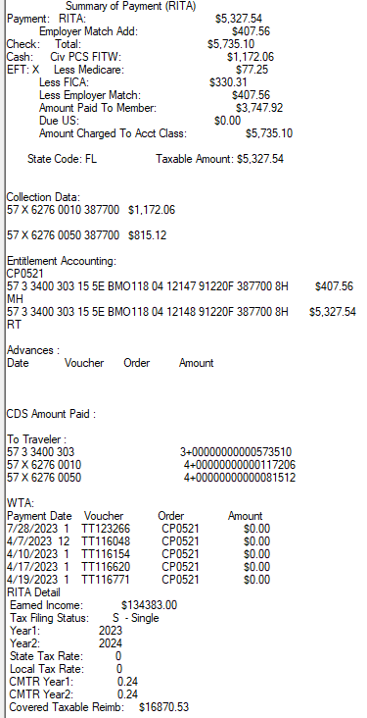
RITA without WTA
The employee was paid five taxable vouchers in 2023
No WTA was elected.
Total taxable amount - $16,870.53
According to the taxable income of $134,383.00 on the IRS 1040, the employee falls into the 24% tax bracket.
The RITA is computed to pay taxes at the CMTR for 2023.
The payment of $5,335.10 is taxable. Ref slide 6.

Slide 17
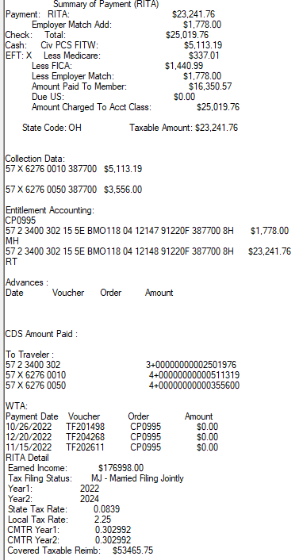
How State and Local Taxes Impact RITA
The employee was paid three taxable vouchers in 2022
No WTA was elected.
Total taxable amount - $53,465.75
According to the taxable income of $176,988.00 on the IRS 1040, the employee falls into the 22% tax bracket.
The RITA is computed to pay taxes at the CMTR for 2022.
Claims two states for RITA. Ohio has state taxes 3.99% and locality taxes 2.25% and Colorado has 4.4%.
The payment of $23,241.76.01 is taxable. Ref slide 6.

Slide 18
Points of Contact
If you have questions or need to file a RITA voucher, please contact you local finance office.

